Slide 1



WWW.GROUNDGURUS.NET

Slide 2


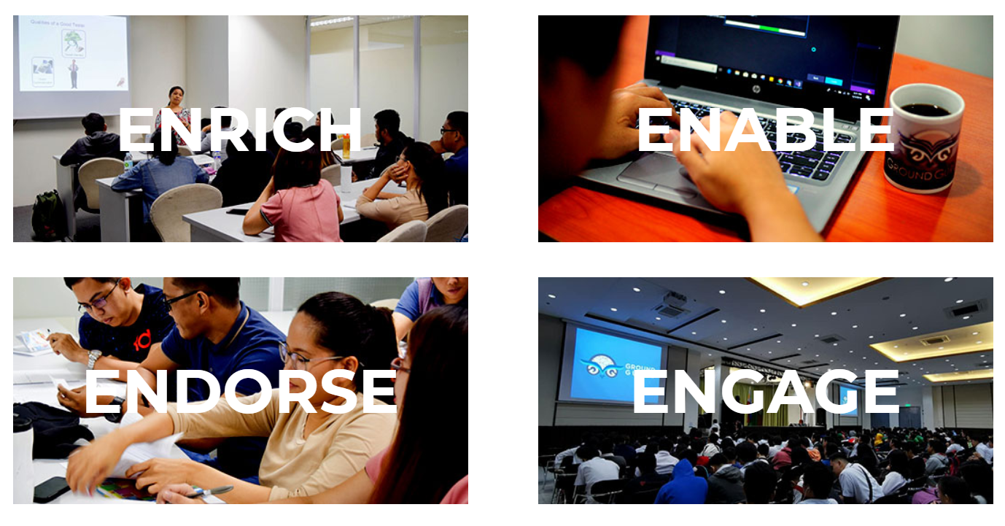

Slide 3
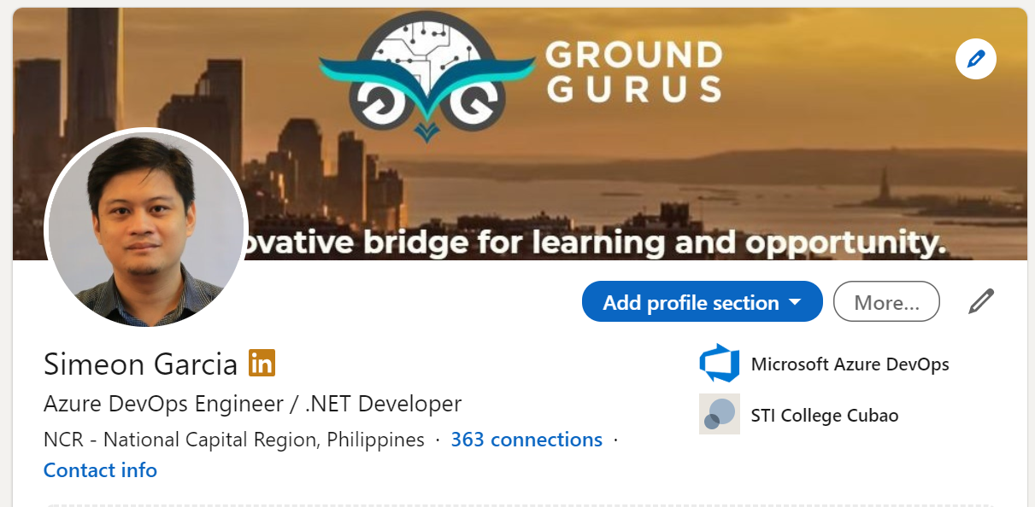

Slide 4
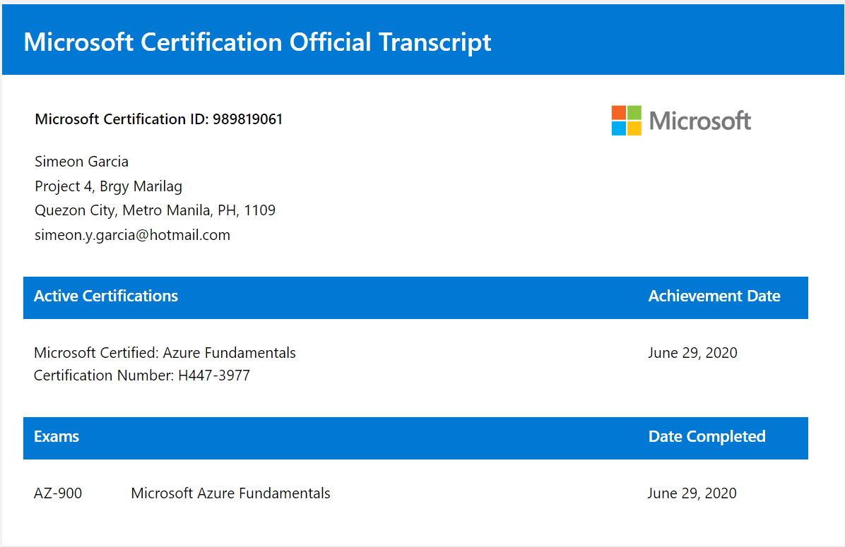

Slide 5
Session 1: Agenda
Session 1 covers the environment setup and overview of our sample application which is Inventory Management System.
1.1 Overview of ASP.NET Core
ASP.NET evolution, benefits, and supported platforms.
1.2 Environment Setup
Pre-requisites, tools needed, and environment test.
1.3 Project Structure
Separation of layer functions, built-in structure.
1.4 Hands On: Inventory Management System
IMS Models and Properties, aligning layers to IMS Project.

Slide 6
What is ASP.NET Core
What is ASP.NET Core ?
Redesign of original ASP.NET Framework
High-performance framework for building cloud-based, internet-based applications.
Key Benefits
Cross Platform: runs on Windows, macOS, and Linux
High Performance: optimized forclodu environments and microservices
Dependency Injection: Built-in support for dependency injection.
.NET 8.0
Improved build performance system.
Improved micro services support.
Enhanced support for containerization.

Slide 7
Development Environment Setup
Step
Step
Step
Visual Studio Community
Visual Studio Enterprise
Visual Studio Enterprise
Visual Studio Code
01
02
03
Download Visual Studio Community/ Professional/
Enterprise
Install.NET 8.0 SDK
Install EF Core
Check if you can create .NET 8.0 ASP.NET Core Project
Step
Step
Step
Microsoft.EntityFrameworkCore
Microsoft.EntityFrameworkCore.SqlServer
Microsoft.EntityFrameworkCore.Tools
Microsoft.EntityFrameworkCore.Design
Microsoft.AspNetCore.Identity.EntityFrameworkCore
06
05
04
Test run the project
Install necessary package for your web application
Create Sample ASP.NET Core Web Project

Slide 8
Project Structure
ASP.NET Core Project is typically organized into key areas to promote separation of concerns and maintainability.
Startup and Configuration
Controllers and API
Services and Business Logics
Data Access

Slide 9
Inventory Management
(Software Design Phase)
Application Structure
User Registration
Authentication
Authorization
Data Structure
Models
Entity Framework
P1
P2
Product Maintenance(CRUD)
ADD / DISPLAY / UPDATE / DELETE
Product Page Enhancements
Bootstrap Framework
Icons
P3
P4

Slide 10
WHAT IS ASP.NET Core ?
Open source library for building user interfaces
NOT A FRAMEWORK
Focus on UI
Rich Ecosystem
Crated and Maintained by Meta

Slide 11
